Slide 1
Life Expectancy Prediction using Machine Learning

Slide 2

HELLO!
We are Yash Verma (04410102718) and Suraj Singh (20210102718)

Slide 3
Acknowledgement
MENTOR : Dr. Ram Shringar Rao
Dr. Ram Shringar Rao received his B.tech, M-Tech and PhD in the field of Computer Science and Engineering. He has experience of more than 10 years in teaching. He has to his credit more than 30 papers in International Journal, and Conferences. He has also guided 4 PG Thesis's and also more than 12 UG projects. His research interests include Mobile Ad Hoc Network , Vehicular Ad Hoc Network , and Theory of computation.
CO-ORDINATOR: Mr. Prakash Rao Ragiri
Mr. Prakash Rao Ragiri received his B.tech , M-Tech in the field of the Computer Science and Engineering and currently pursuing Ph.D from JNU, Delhi. He has 12+ Years of experience in teaching and and 2 years experience as a Research fellow and Engineer at CDAC , Noida. He has to his credit 10 Publication and guided mode than 12 PG and 25 UG student Thesis and projects respectively. His area of Specialization include Computer Networks , MANETS , OOPS and Computer Forensics.

Slide 4
Motivation
“A man is made by his beliefs. As he believes. So he becomes.” – Lord Krishna

Slide 5
Motivation for the Project
Predict life expectancy by looking at the positive and negatively correlated factors to improve life quality.
Try to discern any differences between countries groupings
Serves as an example for countries to assess and to improve life expectancy for their citizens.
To discover the trend of life expectancy around the globe

Slide 6
DATA SET
Everything start with right Data Set.

Slide 7
DATASET INFORMATION
Data is from The World Health Organization and United Nations website, Life Expectancy expresses the results of 193 countries for life expectancy with 2938 rows for 20 different features columns spanning from 2000-2015 with 2563 missing values.
The features vary from whether country demographics such as Population, GDP, Total Expenditure spend on health to population statistics such immunizations and mortality rates along with BMI, Alcohol Consumption, and years of schooling.

Slide 8
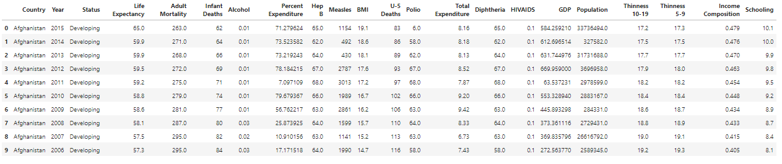
A look into the dataset
“Data is the new oil.” — Clive Humby

Slide 9
FEATURE LIST
Country
Name of the country whose data is represented by the row.
Year
Year in which data in which data is recorded.
Status
Wheater Country is Developed or Developing.
Life Expectancy
Life expectancy is a statistical measure of the average time an organism is expected to live.
Adult Mortality
Adult Mortality Rates of both sexes(probability of dying between 15&60 years per 1000 population)
Infant Deaths
Number of Infant Deaths per 1000 population

Slide 10
FEATURE LIST …
Alcohol
Alcohol, recorded per capita (15+) consumption (in liters of pure alcohol)
Percent Expenditure
Expenditure on health as a percentage of Gross Domestic Product per capita(%)
Hepatitis B
Hepatitis B (HepB) immunization coverage among 1-year-olds(%)
Measles
Number of reported measles cases per 1000 population
BMI
Average Body Mass Index of entire population.
U-5 Deaths
Number of under-five deaths per 1000 population

Slide 11
FEATURE LIST …
Polio
Polio(Pol3) immunization coverage among 1-year-olds(%).
Total Expenditure
General government expenditure on health as a percentage of total government expenditure(%)
Diphtheria
Diphtheria tetanus toxoid and pertussis (DTP3) immunization coverage among 1-year-olds(%)
HIV/AIDS
Deaths per 1000 live births HIV/AIDS(0-4 years)
GDP
Gross Domestic Product per capita(in USD).
Population
Population of the country

Slide 12
FEATURE LIST …
Population Thinness 10-19
Prevalence of thinness among children and adolescents for Age 10 to 19(%)
Thinness 5-9
Prevalence of thinness among children for Age 5 to 9(%)
Income Composition
Human Development Index in terms of income composition of resources(0-1)
Schooling
Number of years of Schooling

Slide 13
Feature Engineering
Population and GDP will be dropped due to discrepancies with the data. They would useful to have, but it is more likely to hinder the data due to poor reporting from there. The combination of the features will be a good litmus to measure life expectancy.
Replace Missing Values Associated with Country Feature Mean where applicable.
In other cases, fill in data with associated country status mean

Slide 14
Feature Engineering …
The data cleaning included removed 1100 removed between GDP(448) and Population (652).
818 values replaced with missing respective country means.
645 replaced by the mean related to the status of the country

Slide 15
DATA ANALYSIS
“The goal is to turn data into information, and information into insight.” – Carly Fiorina, former executive, president, and chair of Hewlett-Packard Co.

Slide 16
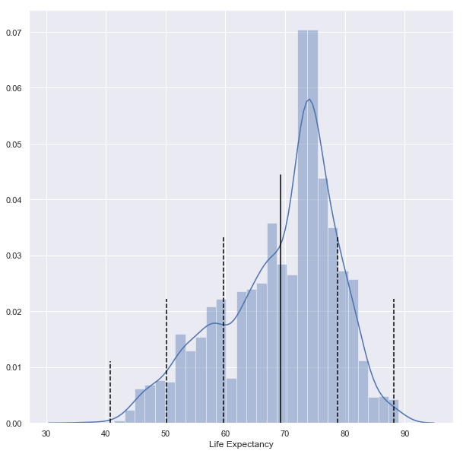
LIFE EXPECTANCY
Maximum Value : 89.0 Years
Mean Value : 69.2 Years
Minimum Value : 36.3 Years
Standard Daviation : 9.5 Years

Slide 17
Conclusion no. 1
The maximum value 89.0 Years is about 2.08 standard deviations away from the mean 69.2 Years while the minimum 36.3 Years is about 3.46 deviations away. The standard deviation for the whole sample is 9.50 years

Slide 18
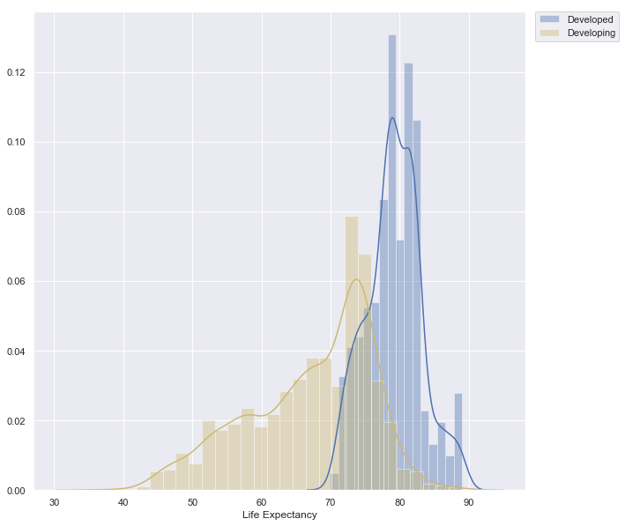
LIFE EXPECTANCY ( Developed VS. Developing countries)

Slide 19
LIFE EXPECTANCY ( Developed VS. Developing countries)
 | MEAN | MAX | MIN
Developed | 79.197852 | 89.0 | 69.9
Developing | 67.111465 | 89.0 | 36.3

Slide 20
Conclusion no. 2
The cut off boundary age between developing and developed is 69.9 Years.

Slide 21
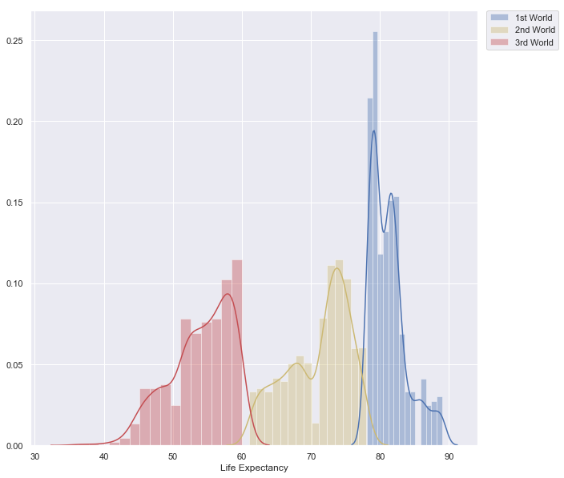
LIFE EXPECTANCY (1st, 2nd and 3rd world countries)

Slide 22
LIFE EXPECTANCY ( Developed VS. Developing countries)
 | MEAN | MAX | MIN
1st World | 81.244111 | 89.0 | 78.1
2nd World | 71.043108 | 78.0 | 61.0
3rd World | 53.994613 | 60.0 | 36.3

Slide 23
Conclusion no. 3
1st world countries are considered over 70.0 Years while 2nd world countries are over 60.0 Years and rest can be considered as 3rd world countries.

Slide 24
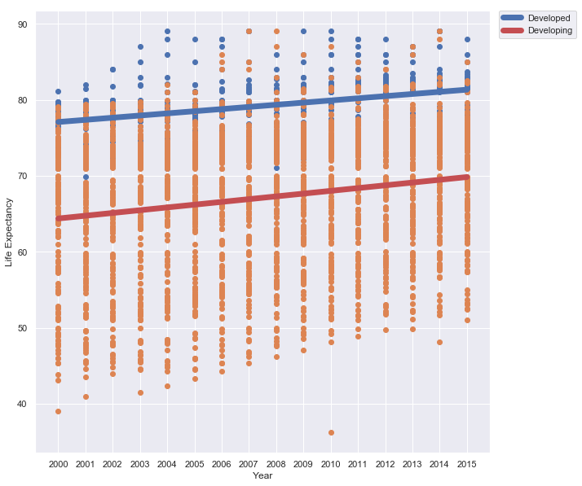
LIFE EXPECTANCY VERSUS YEAR

Slide 25
Conclusion no. 4
Life Expectancy hits its lowest in 2001 for developed countries and in 2010 it is lowest for developing countries.

Slide 26
Machine Learning
“Just as electricity transformed almost everything 100 years ago, today I actually have a hard time thinking of an industry that I don’t think AI (Artificial Intelligence) will transform in the next several years.” ~Andrew Ng

Slide 27
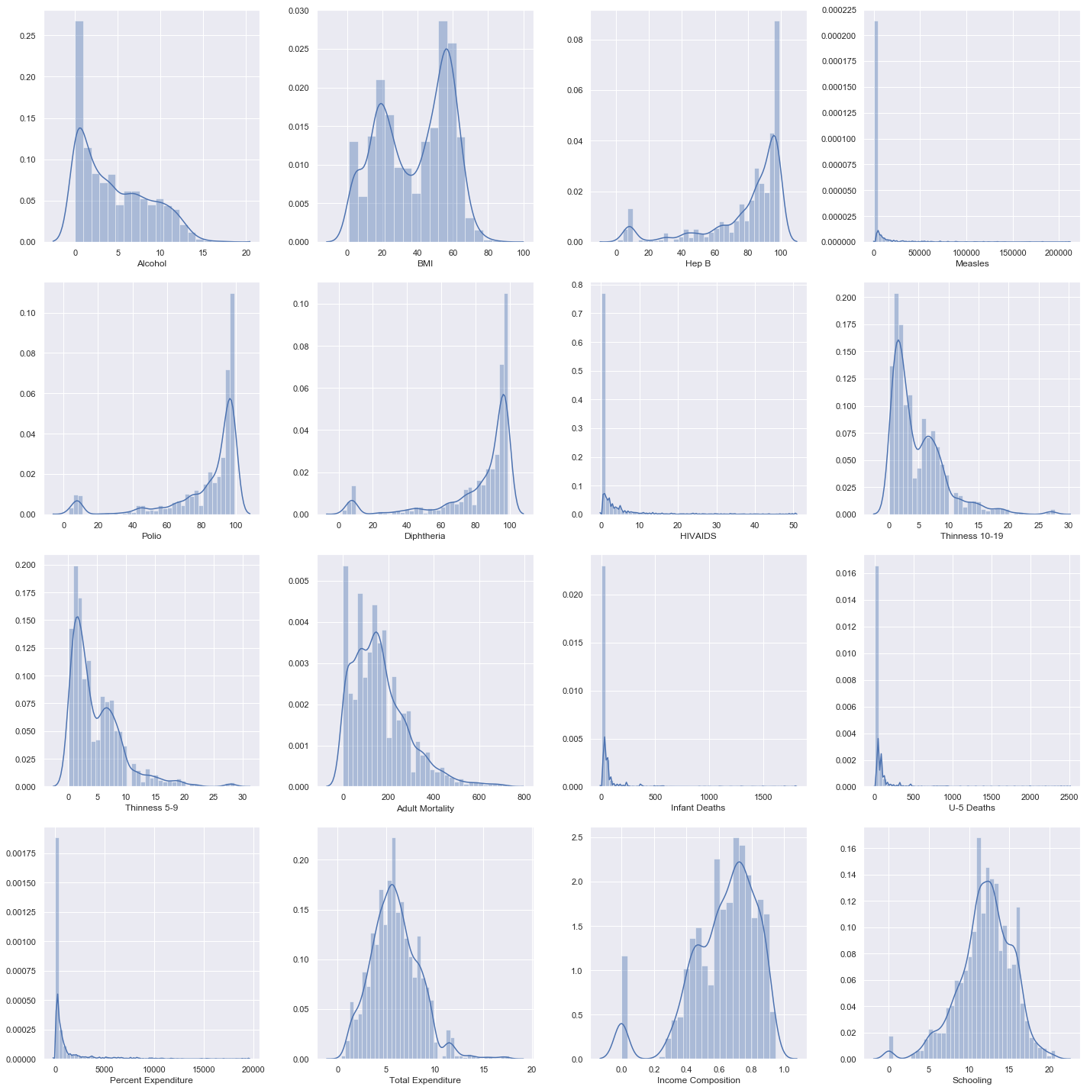
Distplot of various Feature
our office

Slide 28
Parameters…
#Developed Training Data
X_developed_train=df_reg[(df_reg['Status']==1)&(df_reg['Year']<2011)].drop('Life_Expectancy',axis=1)
Y_developed_train=df_reg[(df_reg['Status']==1)&(df_reg['Year']<2011)]['Life_Expectancy']
#Developed Testing Data
X_developed_test=df_reg[(df_reg['Status']==1)&(df_reg['Year']>2011)].drop('Life_Expectancy',axis=1)
Y_developed_test=df_reg[(df_reg['Status']==1)&(df_reg['Year']>2011)]['Life_Expectancy']
#Developing Training Data
X_developing_train=df_reg[(df_reg['Status']==0)&(df_reg['Year']<2011)].drop('Life_Expectancy',axis=1)
Y_developing_train=df_reg[(df_reg['Status']==0)&(df_reg['Year']<2011)]['Life_Expectancy']
#Developing Testing Data
X_developing_test=df_reg[(df_reg['Status']==0)&(df_reg['Year']>2011)].drop('Life_Expectancy',axis=1)
Y_developing_test=df_reg[(df_reg['Status']==0)&(df_reg['Year']>2011)]['Life_Expectancy']
#World=1 Testing Data
X_world1_test=df_reg[(df_reg['world']==1)&(df_reg['Year']>2011)].drop('Life_Expectancy',axis=1)
Y_world1_test=df_reg[(df_reg['world']==1)&(df_reg['Year']>2011)]['Life_Expectancy']
#World=2 Training Data
X_world2_train=df_reg[(df_reg['world']==2)&(df_reg['Year']<2011)].drop('Life_Expectancy',axis=1)
Y_world2_train=df_reg[(df_reg['world']==2)&(df_reg['Year']<2011)]['Life_Expectancy']
#World=2 Testing Data
X_world2_test=df_reg[(df_reg['world']==2)&(df_reg['Year']>2011)].drop('Life_Expectancy',axis=1)
Y_world2_test=df_reg[(df_reg['world']==2)&(df_reg['Year']>2011)]['Life_Expectancy']
#World=3 Training Data
X_world3_train=df_reg[(df_reg['world']==3)&(df_reg['Year']<2011)].drop('Life_Expectancy',axis=1)
Y_world3_train=df_reg[(df_reg['world']==3)&(df_reg['Year']<2011)]['Life_Expectancy']
#World=3 Testing Data
X_world3_test=df_reg[(df_reg['world']==3)&(df_reg['Year']>2011)].drop('Life_Expectancy',axis=1)
Y_world3_test=df_reg[(df_reg['world']==3)&(df_reg['Year']>2011)]['Life_Expectancy']

Slide 29
Parameters…
#Full Training Set
X_train=df_reg[df_reg['Year']<2011].drop('Life_Expectancy',axis=1)
Y_train=df_reg[df_reg['Year']<2011]['Life_Expectancy']
#Full Testing Set X_test=df_reg[df_reg['Year']>2011].drop('Life_Expectancy',axis=1)
Y_test=df_reg[df_reg['Year']>2011]['Life_Expectancy']
#Full Set
X=df_reg.drop('Life_Expectancy',axis=1)
Y=df_reg['Life_Expectancy']
#Breakdown
Xlist=[X_developed_train,X_developed_test,X_developing_train,X_developing_test,
X_world1_train,X_world1_test,X_world2_train,X_world2_test,
X_world3_train,X_world3_test, X_train,X_test,X]
Ylist=[Y_developed_train,Y_developed_test,Y_developing_train,Y_developing_test,
Y_world1_train,Y_world1_test,Y_world2_train,Y_world2_test,
Y_world3_train,Y_world3_test, Y_train,Y_test,Y]
xlist=['X_developed_train','X_developed_test','X_developing_train','X_developing_test',
'X_world1_train','X_world1_test','X_world2_train','X_world2_test','X_world3_train',
'X_world3_test', 'X_train','X_test','X']
status=['Developed','Developed','Developing','Developing',
'1st World','1st World','2nd World','2nd World',
'3rd World','3rd World', 'Full Training','Full Testing','Full']

Slide 30
Regression
Regression algorithms predict the output values based on input features from the data fed in the system. The go-to methodology is the algorithm builds a model on the features of training data and using the model to predict the value for new data.

Slide 31
Thiel-sen Regression
Compared to the OLS (ordinary least squares) estimator, the Theil-Sen estimator is robust against outliers. It has a breakdown point of about 29.3% in case of a simple linear regression which means that it can tolerate arbitrary corrupted data (outliers) of up to 29.3% in the two-dimensional case.
The estimation of the model is done by calculating the slopes and intercepts of a subpopulation of all possible combinations of p subsample points. If an intercept is fitted, p must be greater than or equal to n features + 1. The final slope and intercept is then defined as the spatial median of these slopes and intercepts.
In certain cases Theil-Sen performs better than RANSAC which is also a robust method. Tuning the residual threshold parameter of RANSAC remedies this but in general a priori knowledge about the data and the nature of the outliers is needed. Due to the computational complexity of Theil-Sen it is recommended to use it only for small problems in terms of number of samples and features. For larger problems the max_subpopulation parameter restricts the magnitude of all possible combinations of p subsample points to a randomly chosen subset and therefore also limits the runtime. Therefore, Theil-Sen is applicable to larger problems with the drawback of losing some of its mathematical properties since it then works on a random subset.

Slide 32
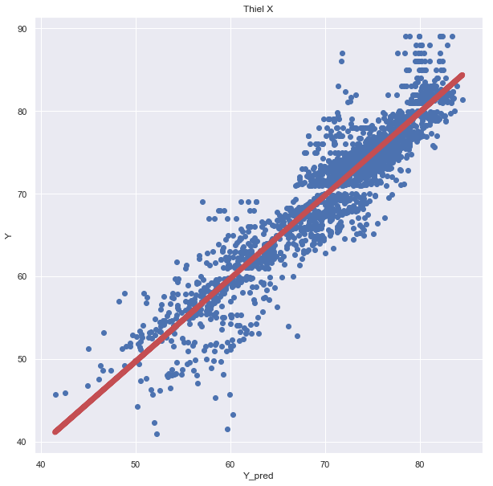
Result for Thiel-Sen
R^2 Score:0.8572
RMSE: 3.191
Minimum LE: 41.5
Maximum LE: 84.5
Average Predicted LE: 70.9
LE Standard Deviation: 7.791
LE Variance: 60.694

Slide 33
Ridge Regression
This model solves a regression model where the loss function is the linear least squares function and regularization is given by the l2-norm. Also known as Ridge Regression or Tikhonov regularization. This estimator has built-in support for multi-variate regression (i.e., when y is a 2d-array of shape (n_samples, n_targets)).
Ridge regression was developed as a possible solution to the imprecision of least square estimators when linear regression models have some multicollinearity (highly correlated) independent variables—by creating a ridge regression estimator (RR). This provides a more precise ridge parameters estimate, as its variance and mean square estimator are often smaller than the least square estimators previously derived.
Ridge regression is a method of estimating the coefficients of multiple-regression models in scenarios where independent variables are highly correlated.

Slide 34
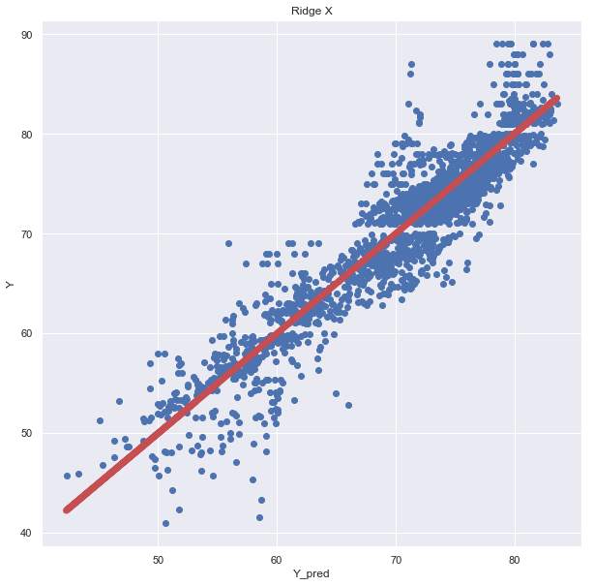
Result for Ridge
R^2 Score: 0.8685
RMSE: 3.062
Minimum LE: 42.3
Maximum LE: 83.5
Average Predicted LE: 70.7
LE Standard Deviation: 7.846
LE Variance: 61.553

Slide 35
Gradient Boosting Regression
Gradient boosting algorithm is one of the most powerful algorithms in the field of machine learning. As we know that the errors in machine learning algorithms are broadly classified into two categories i.e. Bias Error and Variance Error. As gradient boosting is one of the boosting algorithms it is used to minimize bias error of the model.
Gradient boosting is a machine learning technique for regression, classification and other tasks, which produces a prediction model in the form of an ensemble of weak prediction models, typically decision trees.
Gradient boosting algorithm can be used for predicting not only continuous target variable (as a Regressor) but also categorical target variable (as a Classifier). When it is used as a regressor, the cost function is Mean Square Error (MSE) and when it is used as a classifier then the cost function is Log loss.

Slide 36
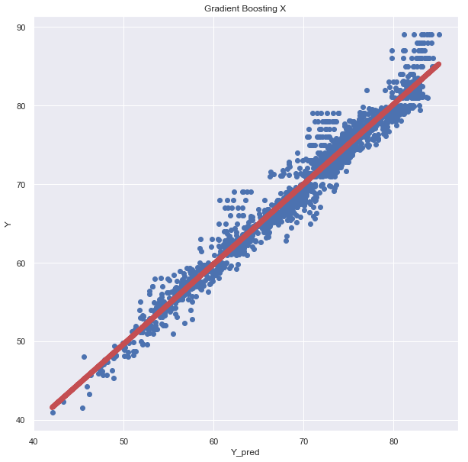
Result for Gradient Boosting
R^2 Score: 0.9601
RMSE: 1.688
Minimum LE: 42.0
Maximum LE: 85.0
Average Predicted LE: 70.7
LE Standard Deviation: 8.147
LE Variance: 66.366

Slide 37
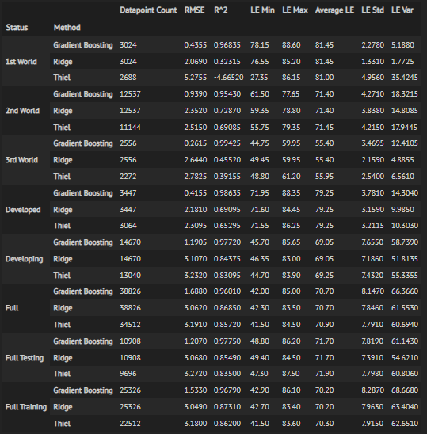
FINAL RESULT

Slide 38
Final Result for Regression algorithms
Theil is the worst performing model, but is runs better with more data. This should be due to it being a financial/economic model which it better suited for more data.
Ridge is a mixed bag of results, but showed some promising results.
Gradient Boosting is the chosen model for regression due its consistent performance and ability to deal with all types and set of data. It captures the LE range ,mean, and standard deviation and allows the user to see which features play a key factor in model performance. Given the lower amount of data for this model, it works well and quickly with more data and factors, it is likely to fall off. This is however very promising given the amount of cleaning present at the beginning.

Slide 39
Clustering
Clustering or cluster analysis is a machine learning technique, which groups the unlabelled dataset. It can be defined as "A way of grouping the data points into different clusters, consisting of similar data points.

Slide 40
Scores for Clustering algorithms
Calinski-Harabaz Index, additionally known as the Variance Ratio Criterion where a higher score means a better defined cluster. It compares the ratio of the between-clusters dispersion mean and the within-cluster dispersion. Scores are higher when dense and separated from other clusters. The score is normalized with respect to the others scores for comparison in one chart.
Silhouette Score is the ratio of difference between the mean nearest-cluster distance and mean intra-cluster distance over the maximum between both scores. The score ranges from -1 to +1. +1 indicates a highly dense cluster while scores close to 0 indicates overlapping clusters and -1 indicates incorrect clustering.
s = (b-a) / max ( b , a )
mean intra-cluster distance (a)
mean nearest-cluster distance (b)

Slide 41
Scores for Clustering algorithms
Homogeneity Score- A clustering result satisfies homogeneity if all of its clusters contain only data points which are members of a single class.
Completeness Score- A clustering result satisfies completeness if all the data points that are members of a given class are elements of the same cluster.
Adjusted Rand Score- The Rand Index compares how pairs of data points relate in the ground truth and in the post-clustering assignment. There are four possible types of pair relationships:
a=Members of the same cluster in the ground truth match same cluster in the new solution. b=Members of the same cluster in the ground truth match different clusters in the new solution. c=Members of different clusters in the ground truth match the same cluster in the new solution. d=Members of different clusters in the ground truth match different clusters in the new solution. E(RI)- expected RI RI=( a + c )/sum( a ,b ,c ,d) ARI=(RI-E(RI)/(max(RI)-E(RI))

Slide 42
Mean-Shift Clustering
Mean-Shift Clustering is also an iterative process, but has no input on the number of clusters.
It calculates the probability a data point falls within in n-dimensional space based on the features of the input file. The data points try to move up towards peaks in small steps.
The peaks are determined by the bandwidth ranging from 0 to 1. A higher bandwidth means a smoother surface with defined peaks, while a lower bandwidth has more smaller peaks across a rougher surface.
Once a data point reaches the top of the peak, it stops. After all the data points are settled, the clusters means are formed.

Slide 43
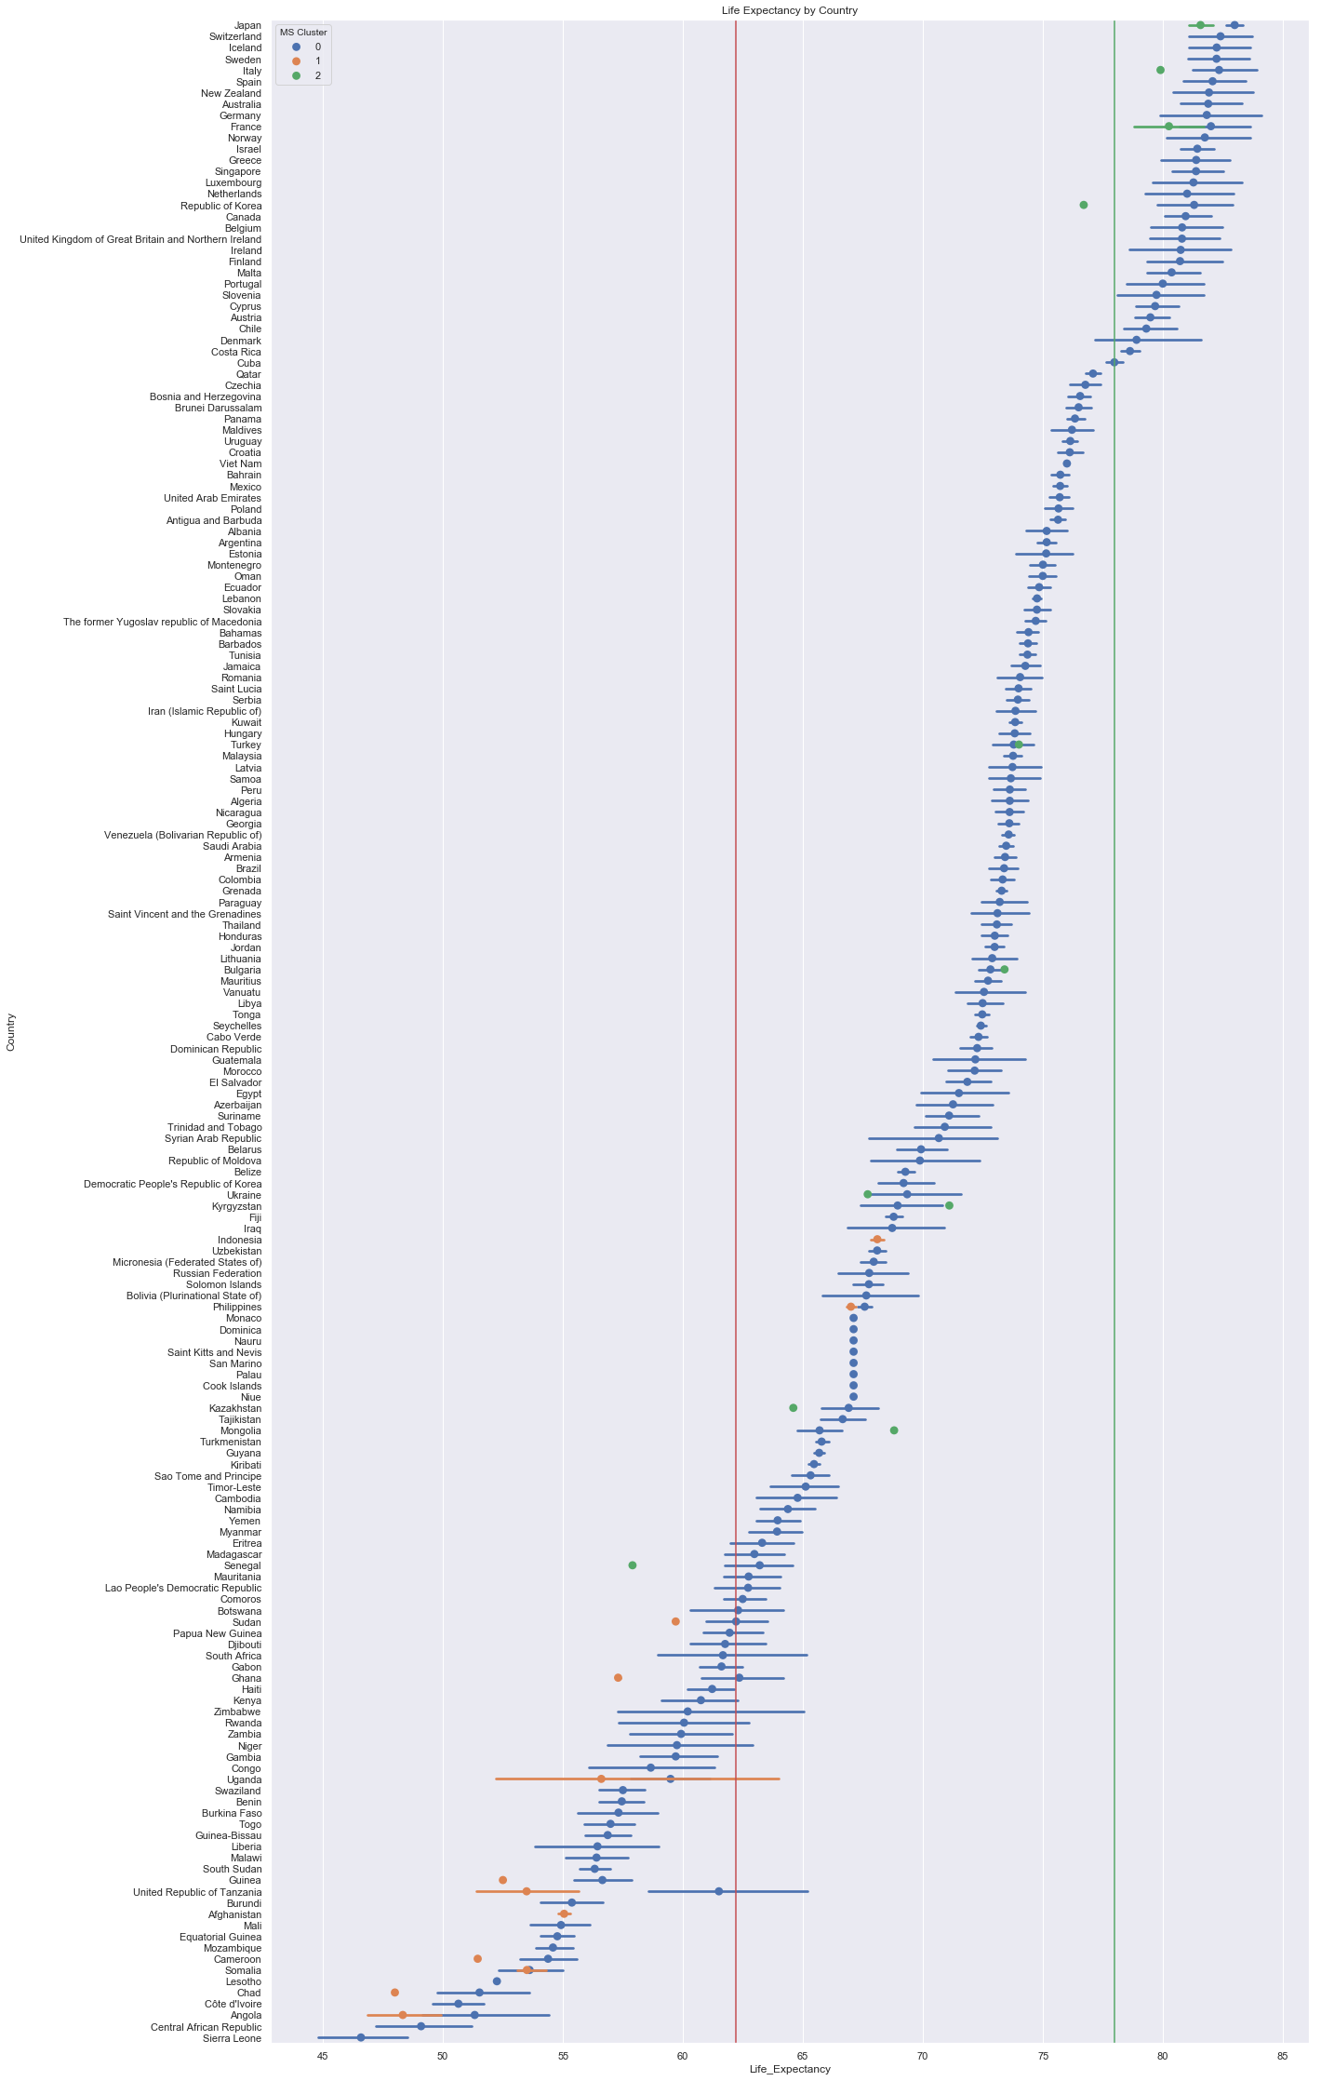
Result for Mean Shift clustering
Number of estimated clusters: 3
Cal-Harabaz Score: 0.08714458789889061
Silhouette Score: 0.3549164206619843
Homogeneity Score: 0.154529924468347
Completeness Score: 0.024506673959922
Adjusted Rand Score: 0.0441812746464792
Cluster Percentage
0 -> 97.5
1 -> 1.9
2 -> 0.6

Slide 44
K-Means Clustering
K-Means Clustering works by assigning a number of clusters and matching each data point with the nearest centroid.
The mean average is taken of all the points and the process is repeated until variance between the new and old clusters fall below a specified threshold value.
It is a commonly run clustering technique.
The number of cluster chosen for k-means will be determined by the scores and running a loop to check the optimal value. The cluster labels will be used to look at the plot again as the hue.

Slide 45
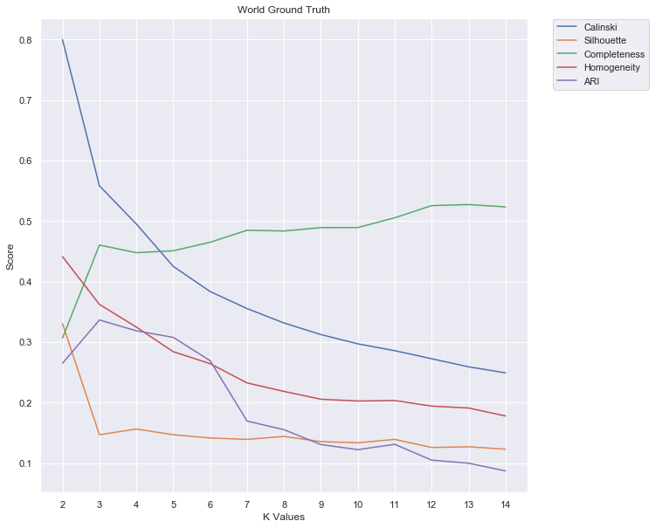
Choosing value of K
k=3 represents the optimal number of clusters for K-means due to the majority of the scores starting to drop off after that point. Completeness continues to rise, but with more clusters that score should keep increasing due to more classes and smaller groupings.

Slide 46
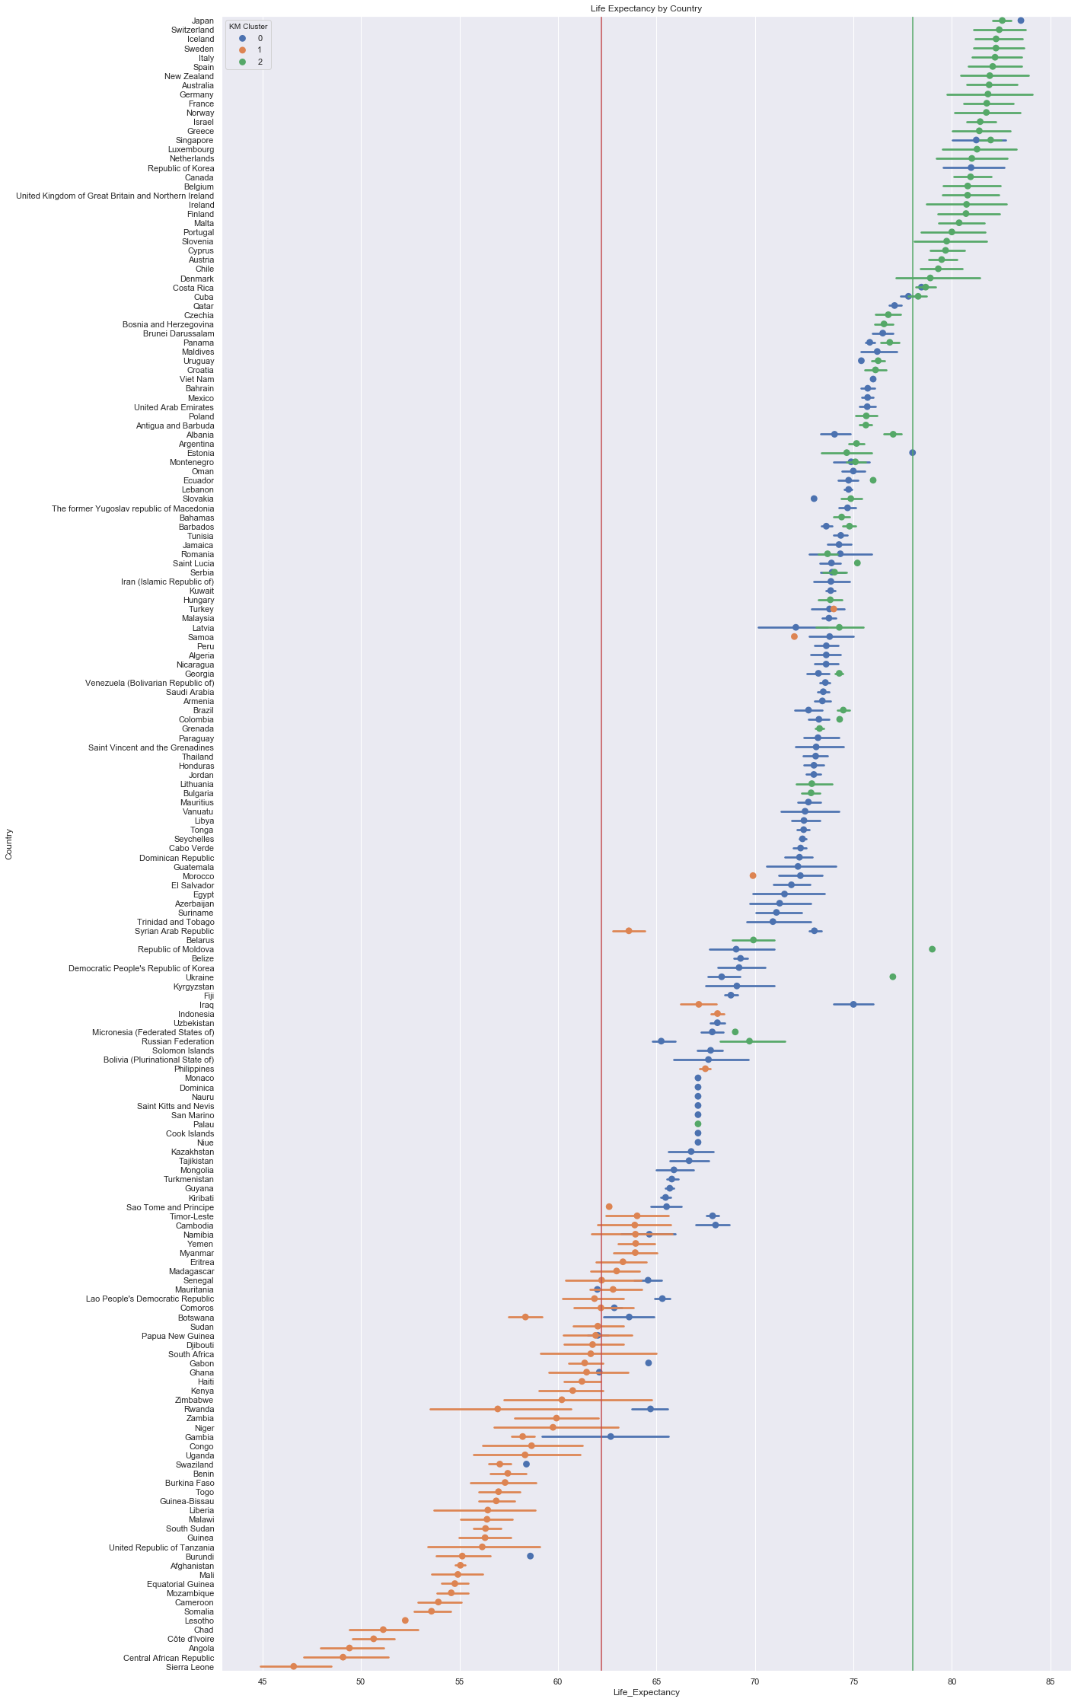
Result for Mean Shift clustering
Number of estimated clusters: 3
Cal-Harabaz Score: 0.5581133185855877
Silhouette Score: 0.14668492002869987
Homogeneity Score: 0.36210369071510323
Completeness Score: 0.4601278185867652
Cluster Percentage:
0 -> 47.5
2 -> 29.3
1 -> 23.3

Slide 47
Final Result for clustering algorithms
K-means scores are more promising here. The silhouette score is low than needed, but some overlap is likely expected base on the dataset in how the countries are grouped. The percentage breakdown is much as well.
Mean shift clustering scores are pretty poor in comparison to the K-Means while also not having a great percentage break down.

Slide 48
MIXED EFFECT MODEL
A mixed model, mixed-effects model or mixed error-component model is a statistical model containing both fixed effects and random effects.

Slide 49
MIXED EFFECT MODEL
Mixed Effect Models have the following assumptions:
The features are related linearly to the outcome.
The errors have constant variance: In other words, the model fits equally well for all values of the outcome and features within a level.
The errors are independent: The fit of the model within a group(level 1) is uncorrelated with the fit of the model at between a group (level 2).
The errors are normally distributed.
Observations within a person/group are correlated with one another(high ICC).

Slide 50
ICC calculation
The Intra-Class Correlation (ICC) defined from a linear mixed model (LMM) reflects the level of behavioral consistency of individual animals across multiple measurements.
First, ICC will be calculated with Life Expectancy by itself to select the correct grouping. ICC represents the ratio of the between cluster variance over the total variance. The total variance is sum of the within-group and between groups unexplained by the fixed variable.
group var: between-group variance resid: within-group variance ICC= group var/(group var +resid)
A low ICC score means that observations within groupings are not similiar than observations between the groupings themselves. A higher ICC indicates that there is a high similarity between observations within a group and a mixed effect model is appropriate. The Country model is very appropriate to have a mixed model performed.

Slide 51
RI (Random Intercepts) Model
A random intercepts model is a model in which intercepts are allowed to vary, and therefore, the scores on the dependent variable for each individual observation are predicted by the intercept that varies across groups.
This model assumes that slopes are fixed (the same across different contexts). In addition, this model provides information about intraclass correlations, which are helpful in determining whether multilevel models are required in the first place.

Slide 52
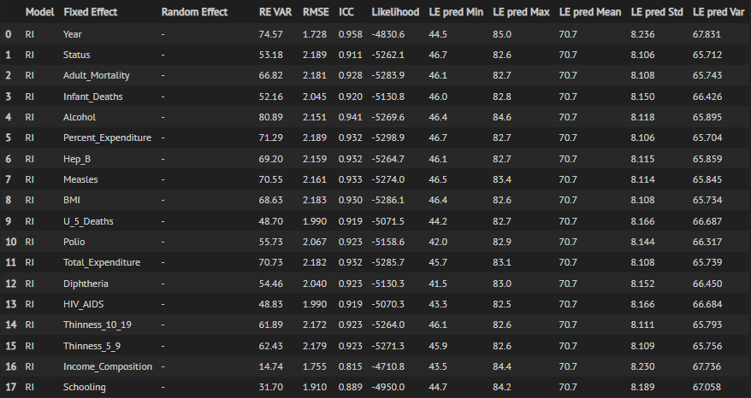
RI Model Result
our office

Slide 53
RS (Random slopes) Model
A random slopes model is a model in which slopes are allowed to vary, and therefore, the slopes are different across groups.
This model assumes that intercepts are fixed (the same across different contexts).
Individuals within a group are allowed to have different slopes while all keeping the same common interval.

Slide 54
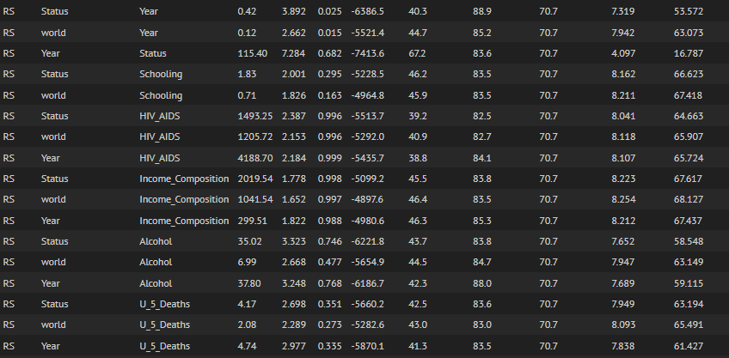
RS Model Result
our office

Slide 55
RIS (Random intercepts and slopes) Model
A model that includes both random intercepts and random slopes is likely the most realistic type of model, although it is also the most complex.
In this model, both intercepts and slopes are allowed to vary across groups, meaning that they are different in different contexts.

Slide 56
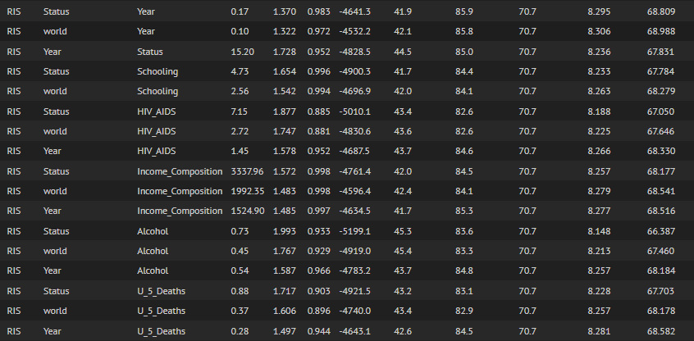
RS Model Result
our office

Slide 57
Final Result for Mixed effect Model
The RIS Models performs the best as whole in reducing RMSE and likelihood. Random Slopes perform the weakest as would be probably all the countries have a separate starting point for year naturally. In the case of RI and RIS models, it may not have the best RMSE, but it captures the overall LE interval better.
The Mixed Effect RIS Model with status as the fixed effect and year as the random effect outperforms all the regular regression and reduces the RMSE down to 1.370.

Slide 58
Conclusion
“In literature and in life we ultimately pursue, not conclusions, but beginnings.” ― Sam Tanenhaus, Literature Unbound

Slide 59
Conclusions
Top 5 Average Life Performance Predictors across all the model are Income Composition, Adult Mortality, HIV_AIDS, Schooling, and Thinness 5-9.
Life Expectancy ranges are Developed(70-89), Developing (41-86), 1st World(78-88), 2nd World(65-78),3rd World(41-65).
The developed and developing status don’t fully cover the different categories of countries. Testing data was generally higher across all groupings due to the year raising LE inherently. In fact, there was a .3 increase every year in Life Expectancy from the models.

Slide 60
Conclusions…
Disease and hunger relief are an universal key to improving life expectancy. This can come in the form of just being smarter and preventing outbreaks by vaccinating. This is helpful when traveling to other countries to keep it away from unknowing populations.
Alcohol is negatively correlated with life expectancy for developed countries and 1st world countries while being positively correlated with 2nd, 3rd, and Developing Countries. In this case, it means that population is living longer, but alcohol consumption is not increasing life expectancy!
Mixed Models are effective, but still need to keep improving! Some measures like covariance can be seen as less useful.

Slide 61
Future Work
The past is a source of knowledge, and the future is a source of hope. Love of the past implies faith in the future. – Stephen Ambrose

Slide 62
Future Work
Look at class within a particular country and see if these same factors are same in determining life expectancy for an individual.
Upper, Middle, and Lower Class ratios could be a very interesting feature to add on to the this study.
Increase the dataset size with continuing UN and Global Data .
There are many variables that are not included in this model that could further describe how to particularly improve standards for Life Expectancy. Some new added features like population, GDP, environmental, and etc. in order to test and clarify country groupings.
Mental Health and Life Expectancy Correlation also seems essential to look further this study!

Slide 63
THANKS!
Any questions?
You can find us at
suraj.singh.e21@nsut.ac.in
yash.verma.e21@nsut.ac.in

